Slide 1
Cyber Security- Threat Overview
23 October 2024

Slide 2
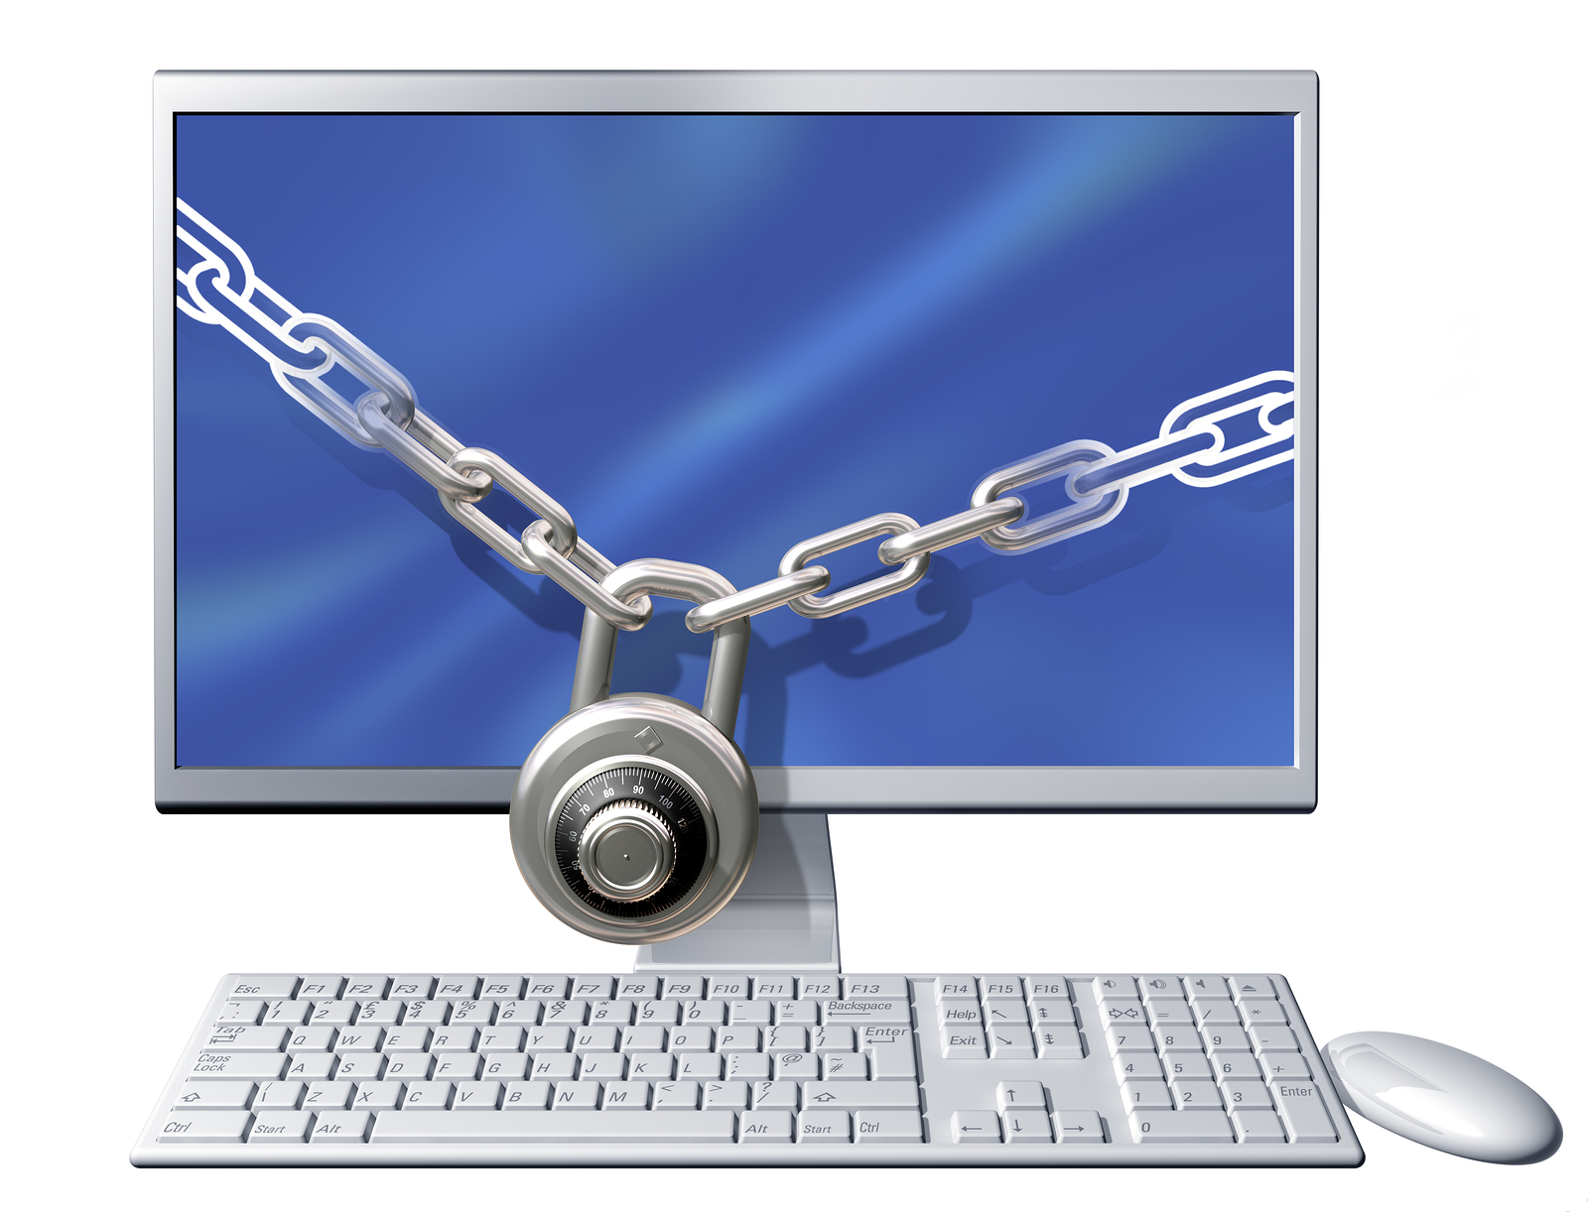
Disturbing Facts
A cyber-attack occurs every ~39 seconds
Email is the primary entry point of ??% malware attacks
Cybercrimes increased by nearly 300% following the COVID-19 outbreak
445 million cyber-attacks were reported in the first quarter of 2024
Supply chain attacks increased by 78% in 2024
The average time it takes for ransomware to start encrypting the files in your PC or network is only 3 seconds
The average cost of a ransomware attack service is $
Human errors are responsible for 95% of breaches
94%
$66

Slide 3
Why Healthcare Data – We aren’t a Bank…
They love Havoc - Causes multi-week outages
Patient diversion to other facilities & emergency services rerouting
Causes a strain on acute care provisioning and capacity
Strain on local communities
Availability / Limited access / cancelled appointments
Delayed procedures
Puts patients’ safety at risk who depend on emergency services
Notes:
Puts patients’ safety at risk who depend on emergency departments, radiology units, and or cancer centers, etc.

Slide 4
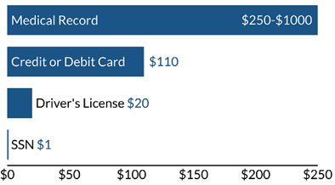
Again – We aren’t a Bank…
Disruptions - For the fun of it!
Will pay
Reuse of data
PII
PHI
Credit card / Banking Accounts
Targeted patients (selling the cancer silver bullet, trials, etc.)
Distribution lists for resale to ransomware attack services and others
Cost per piece of personal information on the Dark Web¹
Notes:
1. Stack, Brian. “Here’s How Much Your Personal Information Is Selling for on the Dark Web.” Experian. December 6, 2017. https://www.experian.com/blogs/ask-experian/heres-how-much-your-personalinformation-is-selling-for-on-the-dark-web/.

Slide 5
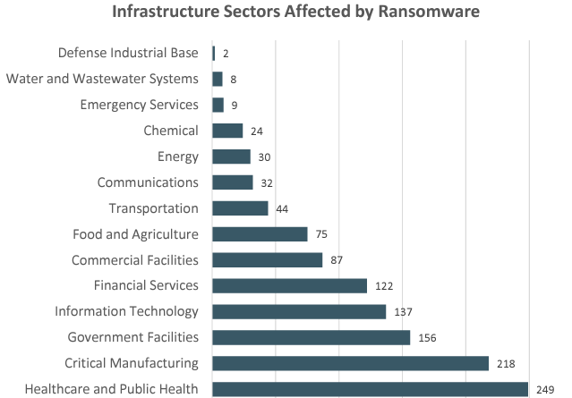
2024 YTD In-Review – Industry Impacts
Change Healthcare – $1B+ (lost revenue, recovery cost $22M ransom)
Acadian (2023 & 2024) – 11M records, $7M demand
Ascension – Malicious download
Largest Ransomware paid to date - $75M Undisclosed Fortune 50 Company
FBI Internet Crime Report, 2023
Office of Civil Rights – Healthcare Breaches 87, 342, 468 as of October
https://ocrportal.hhs.gov/ocr/breach/breach_report.jsf
Notes:
Change Healthcare MFA not in place
OCR
From Health Plans, Healthcare Clearing Houses, & Healthcare Providers for 2022, 2023 and YTD 2024

Slide 6
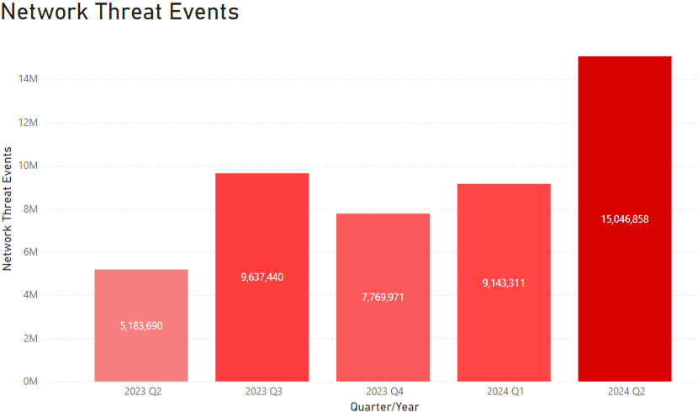
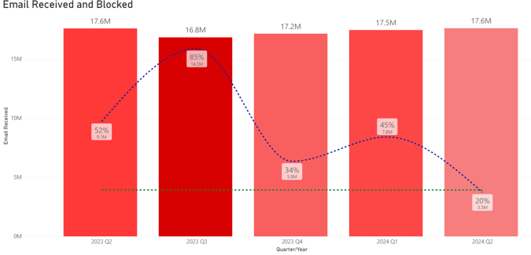
Active Cyber Threats (Constantly being targeted…)
80 known bad actor organizations targeting healthcare sector
45 bad actor organizations targeting transportation providers

Slide 7
Nation-State or Category Adversaries
Naming Conventions
Adversary | Nation- State or Category
 | RUSSIA
 | VIETNAM
 | NORTH KOREA
 | REPUBLIC OF KOREA
 | SYRIA
 | HACTIVIST
 | IRAN
 | PAKISTAN
Adversary | Nation- State or Category
 | GEORGIA
 | COLUMBIA
 | PEOPLES REPUBLIC OF CHINA
 | EGYPT
 | ECRIME
 | INDIA
 | TURKEY
CrowdStrike (2024) 2024 Global Threat Report. https://www.crowdstrike.com/global-threat-report

Slide 8
Artificial Intelligence
Cybersecurity Impacts

Slide 9
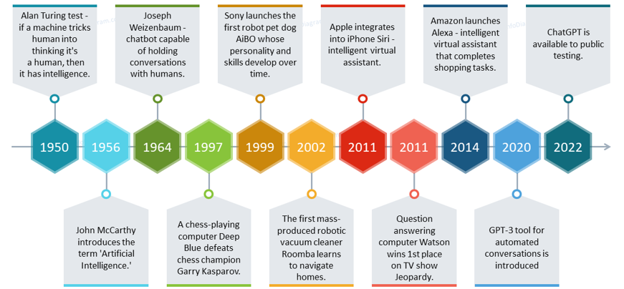
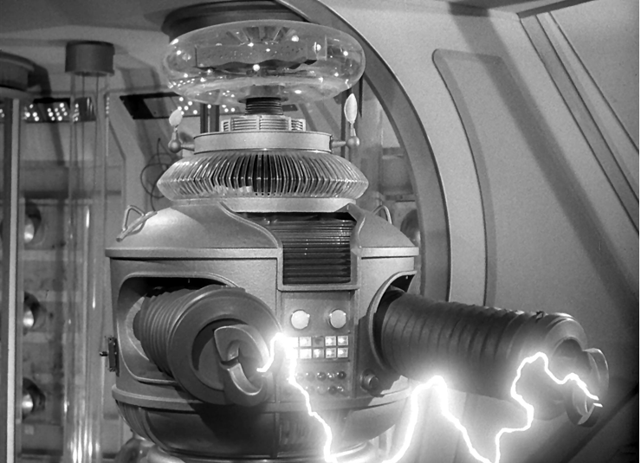
Generative AI
History – Not new, just new to you…
Enhances Productivity
Enhances Cyberattacks
DANGER WILL ROBINSON!
DANGER!
Notes:
History – It’s been around since the 1950s and Alan Turing, British Mathematician kind of gave birth to the idea, and the groundwork really started to take off in the 1960s and 70s
MIT, Stanford, and Carnegie Mellon
First chatbot – ELIZA created by MIT’s Joseph Weizenbaum
American Association of Artificial Intelligence was founded in 180s
Enhances Productivity – we all agree ☺
Drives advanced data analysis, communication, and operational efficiencies
Enhances Cyberattacks
AI aids threat actors in creating sophisticated and HIGHLY effective malware
Malware is stealthier and more evasive than before…
Using LLM (Large Language Models) to spread malicious code into target environments
Deepfakes
How many know what a Deepfake is?
Generative images, videos, and voice recordings that appear
Being used in political elections to spread what may be “fake news” to influence the over 4 billion voting in over 40 countries this year – not just the US.

Slide 10
AI Cyber Attack Stats / Predictions
78% of IT professionals predicted that a severe attack credited to ChatGPT will occur within two years
71% believe that nation-states are already leveraging it for malicious purposes
AI Market projected to reach $14.7 Trillion by 2030
Mostly for legitimate purposes
Bad actors will be using it as well
97% of security stakeholders are concerned about the risks of generative AI in the next twelve months.
98% of cybersecurity professionals believe AI-powered security solutions are needed to detect and block AI-generated threats.

Slide 11
Generative AI and Cyber Attacks
Credential Phishing – Enhanced / realistic landing pages
Endpoint Exploitation – Identified vulnerabilities in software / on systems
BEC & Social Engineering
Craft more believable and legitimate-sounding phishing emails
Malware Creation – Generate new variants of malware (polymorphic)
Help less experienced hackers improve their technical knowledge and develop their skills
Notes:
Credential Phishing - Cybercriminals may employ generative AI techniques to enhance the sophistication and realism of phishing emails and their corresponding landing pages, increasing the chances of tricking users into revealing sensitive information or inputting credentials
Endpoint Exploitation - If an attacker identifies vulnerabilities in software running on endpoints, generative AI could be used to create automated attack payloads. By leveraging AI to create specific code or commands, attackers could automate the delivery of malicious payloads to vulnerable systems and endpoints.
BEC & Social Engineering By inputting specific information about a target and/or previous conversation history, generative AI can be used to engage in conversations with users, attempting to build trust and manipulate them into taking specific actions. The models can generate persuasive messages and be used throughout an entire conversation to convince the target to pay a fake invoice, change banking details, or provide access to sensitive information.
Malware Creation Generative AI can automate the process of generating new variants of malware, making it more challenging for traditional signature-based endpoint protection systems to detect and block them effectively. By leveraging generative AI techniques, attackers can create polymorphic or self-mutating malware that changes its code or behavior, allowing it to evade detection and persist on compromised endpoints.

Slide 12
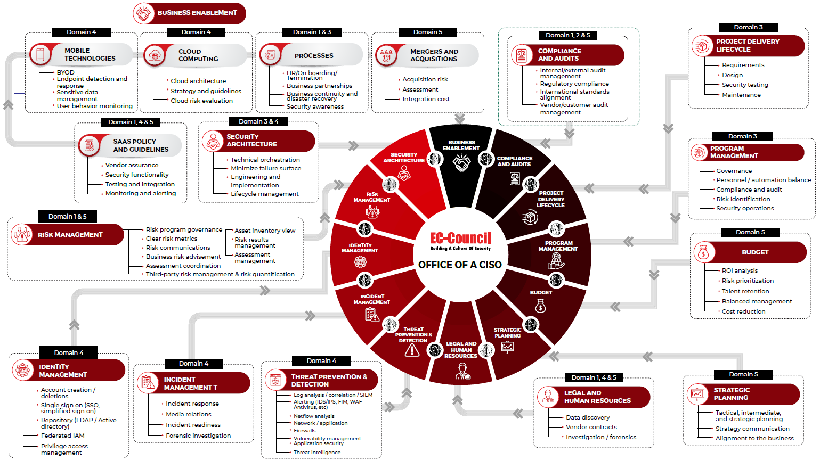
Defense in Depth
Notes:
Domains
1: Governance, Risk, Compliance Domain
2: Information Security Controls and Audit Management Domain
3: Security Program Management & Operations Domain
4; Information Security Core Competencies Domain
5: Strategic Planning, Finance, Procurement, and Third-Party Management

Slide 13
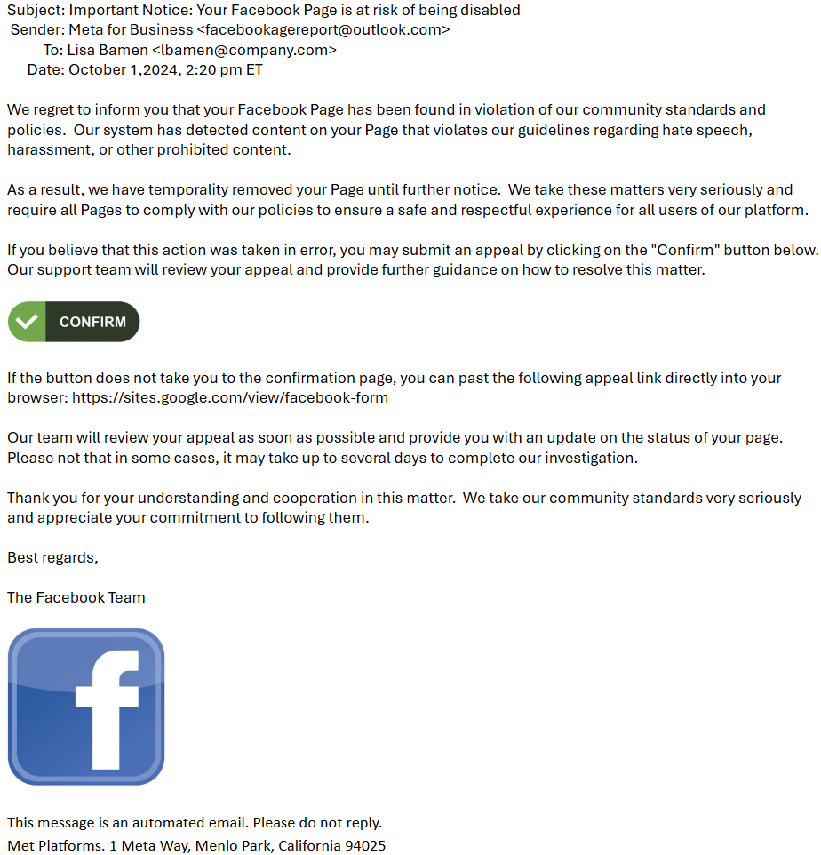
AI Generated Phishing
Grammar
New emails are trending to be more realistic, no misspelled words or grammatical errors
Relevant Topic
Email sent to a company’s admin for their Facebook Page – states their Page has been temporarily removed.
Visceral Response & Instructions
States Page is already removed
Tone is professional
Requests the admin should click on link to file an appeal.
Notes:
If the recipient were to receive this email, they would be much more likely to click the link than if this email had not been generated by AI. The fact that this email is so well-crafted makes it more difficult to detect by humans, underscoring the increased need for email security that can use other signals to detect and block these well-written and convincing attacks.

Slide 14
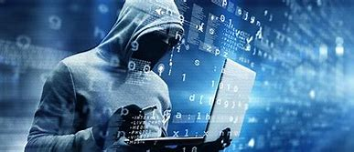
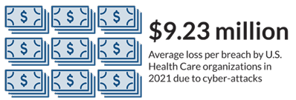
AI, Threat Actors, BGH, and DLS – Oh My…
Big Game Hunting (BGH) Dedicated Leak Sites (DLS)
Cyberattack targeting large, high-value / profile orgs
Who & Why?
Victims are chosen based on their ability to pay a ransom
Likelihood that they will do so to resume business operations or avoid public scrutiny
Common targets
Large corporations
Hospitals and other healthcare institutions
Banks and other financial institutions
Utilities
AI allows Threat Actors to hit faster, with more precision, and adjust on the fly
Notes:
Big Game Hunting Dedicated Leak Sites – Cyberattack targeting large, high-value / profile orgs
Who are they?
Victims are chosen based on their ability to pay a ransom, as well as the likelihood that they will do so in order to resume business operations or avoid public scrutiny. Common targets may include:
Large corporations
Banks and other financial institutions
Utilities
Hospitals and other healthcare institutions
Government agencies
High net worth individuals, such as celebrities and prominent business leaders
Any organization that holds sensitive data, including intellectual property, trade secrets, personal data or medical records

Slide 15
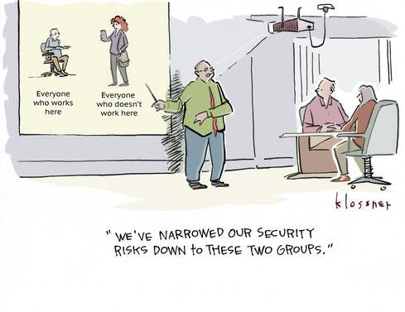
Your Part
Best Defense against Cyberattacks
Slow down
Be the “Human Firewall”
Outlook rules for external emails
Don’t by-pass processes / tools (even if you can)
Corrective Mentality
Work devices not Personal
You are part of the solution as Cybersecurity’s layers of protection
Notes:
Slow Down Reading Email - 90% of malware is delivered via email

Slide 16
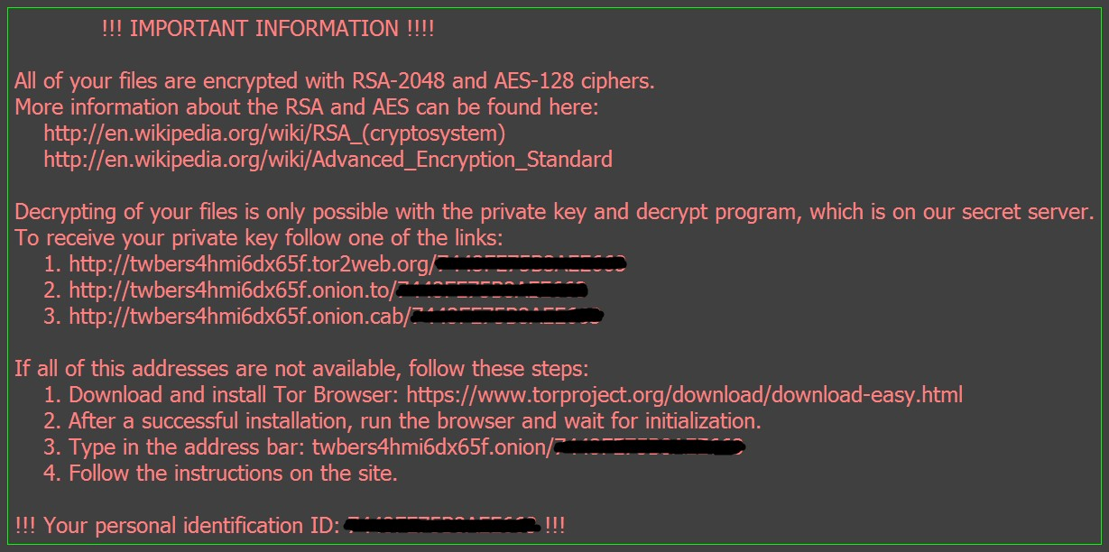
Last think you want to see…

Slide 17
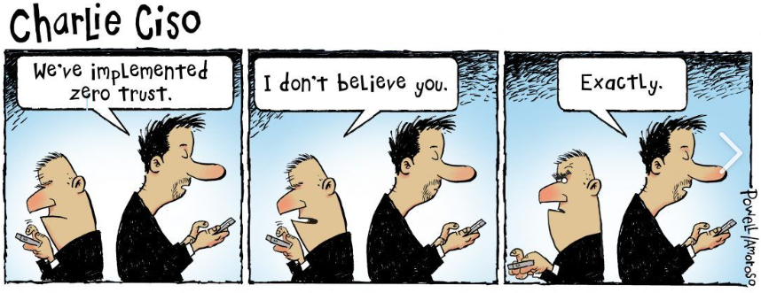
THANK YOU!

